Slide 1
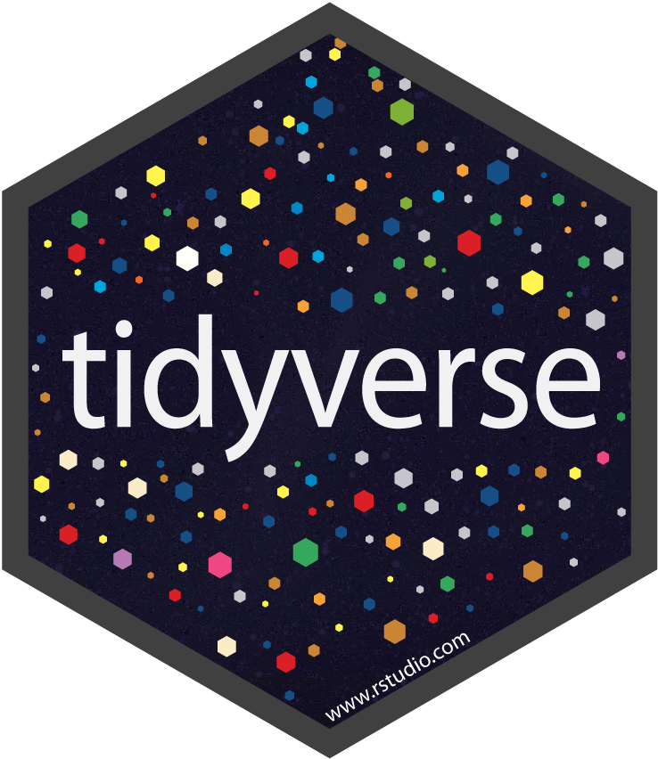
MASTER THE TIDYVERSE
Mike K Smith
Winter 2020
Materials used in this course are derived from
https://github.com/rstudio-education/master-the-tidyverse/
and are shared under a CC-BY-SA-4.0 license.
Notes:
Welcome to the "Master the tidyverse" training session. This is a hands-on, instructor-led training course intended to introduce you to R, the RStudio Integrated Development Environment where you'll develop code but it also has a huge number of helpful tools, and to introduce you to a family of R packages that integrate together to produce a helpful suite for data science tasks.
The majority of the content here has been developed by trainers at RStudio. I'm incredibly grateful to them for providing these excellent slides, and I need to point out that the content is made available under a Creative Commons "Attribution and Share-alike" license, which means that I let you know who developed them initially, but also to let you know that I'm under obligation to share my versions of these, which are available on Github.

Slide 2


HELLO
my name is
Mike
 @MikeKSmith
MikeKSmith
Mike.K.Smith@Pfizer.com
CC BY-SA RStudio
Notes:
My name is Mike K Smith, and I currently work with Doug Lee in the Statistics GPD organisation under Dave Keller. Previously I've worked in the Pharmacometrics group within Clinical Pharmacology for about 12 years and prior to that I was in the Statistics organisation, and I also spent about 6 months working in the StAR group (which is now SPA) working on SAS code for safety reporting algorithms, tables and figures for submission reporting using the TSR system which was the forerunner to CDARS.

Slide 3
Introduction and Visualize Data | 17th Jan
Transforming (subsetting) data | 24th Jan
Importing and reshaping data | 31st Jan
Data Types: strings, factors, date-times | 7th Feb
Iteration | 14th Feb
Modelling | 21st Feb
Reproducible reporting | TBD
CC BY-SA RStudio
Notes:
Our class has 6 planned sessions, and I have tried to split the content into sensible chunks.
In order to cover reproducible reporting including R markdown, I would suggest that at some point we schedule an additional session to cover this topic. There's a lot to talk about in that topic, so I think it needs a dedicated session.

Slide 4
References & resources

Slide 5
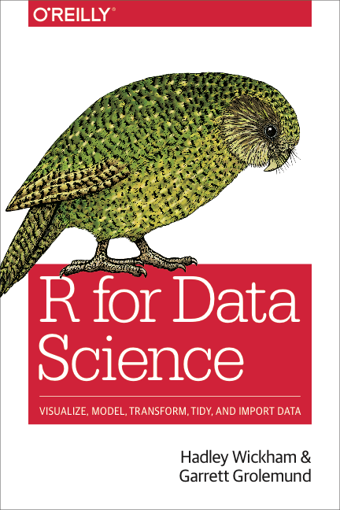
Accompanying book for this course.
Very readable
Covers all the material from the course and more.
Read online at https://r4ds.had.co.nz/
CC BY-SA RStudio
Notes:
R for Data Science is the companion book to this course. It's well worth getting a copy and reading it. It's well laid out, very readable and contains useful examples to check your understanding. All of the material in this course is covered in the book. You can view it online at the link here.

Slide 6
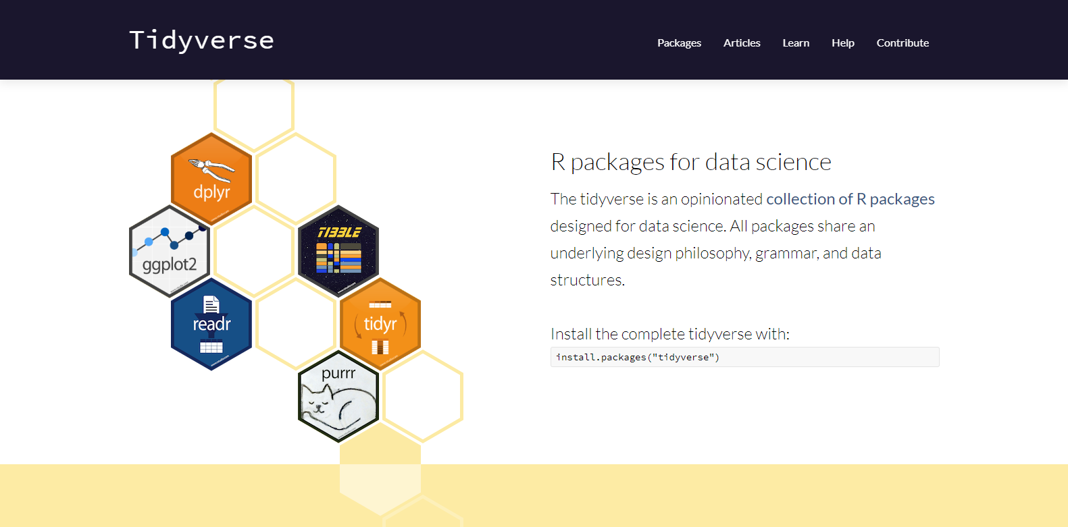
Reference material for all tidyverse packages
http://tidyverse.org
CC BY-SA RStudio
Notes:
The website tidyverse.org is where you should go for all reference material pertaining to the R packages we'll look at. Function descriptions, specific arguments to those functions, example code and additional material is all available on this website.

Slide 7
Introduction to
R & RStudio

Slide 8

What is ?

Slide 9
Statistical programming language
Notes:
R started off as a statistical programming language developed by Ross Ihaka and Robert Gentleman. It's an implementation of the S programming language developed by John Chambers at Bell Labs.

Slide 10
Statistical programming language
Notes:
It's genesis was in STATISTICAL programming

Slide 11
Statistical programming language
Notes:
…but it's now a more general programming language and as we'll see it's possible to do a huge variety of things with R that fall outside statistical programming.

Slide 12
Why
Notes:
So why look at R?

Slide 13
Why not Python,
SAS,
Julia,
Stan,
…
Notes:
Why not other programming languages like Python, SAS, Julia, Stan etc.?

Slide 14
and Python,
SAS,
Julia,
Stan,
…
Notes:
Well to my mind it's not about R *OR* other packages, but rather R *AND* those other packages.
I think the sweet spot comes when we use R alongside those other packages, with R marshalling and reproducible reports like rmarkdown providing the integration point across languages.

Slide 15
Collect
Data
The (data) scientific method
Design Experiment
Explore or Test
Form Hypothesis
Communicate Results
CC BY-SA RStudio
Notes:
But let’s take a moment to remind ourselves about how science works…
We first form a hypothesis, we use this to drive a particular experimental design
We collect data
We then analyse this data
And finally we should communicate our results with others in order to move forward science.

Slide 16
Import data into software
Collect
Data
Tidy data into useable form
Design Experiment
Explore or Test
Form Hypothesis
Transform the data. Do feature engineering.
Deploy app or publish paper
Write code to apply a modeling algorithm.
Build app or write paper
Visualize the data and/or results
Communicate Results
CC BY-SA RStudio
Notes:
But there’s actually a bunch of other steps involved in between each of these, and I’m showing just a few of them here
The key thing here is that *these* steps are the kinds of thing that you can use R and the tidyverse to help you with.

Slide 17
(Applied) Data Science
Import data into software
Collect
Data
Tidy data into useable form
Design Experiment
Explore or Test
Visualize
Form Hypothesis
Transform the data. Do feature engineering.
Import
Tidy
Model
Communicate
Transform
Deploy app or publish paper
Write code to apply a modeling algorithm.
Program
Build app or write paper
Visualize the data and/or results
Communicate Results
CC BY-SA RStudio
Notes:
So when you take these steps and collapse them you get a model for what we can call applied data science

Slide 18
Meet the tools:
R and RStudio

Slide 19
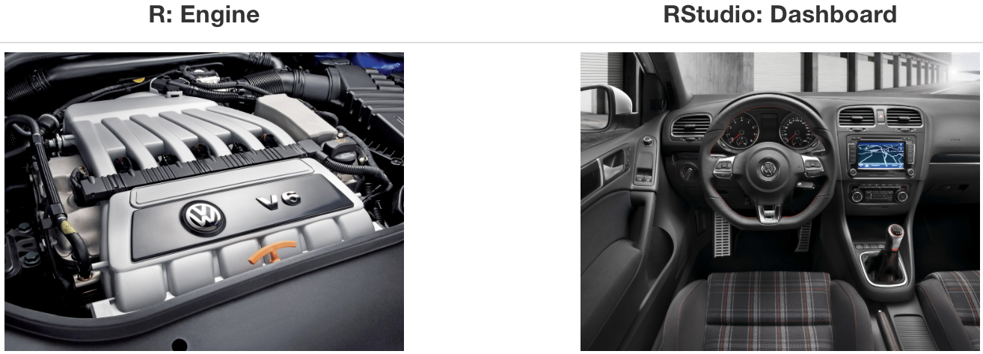
What is RStudio?
Source: Modern Dive
Notes:
So what's the distinction between R and RStudio?
Well a simple analogy is to think of R as the engine that does all the work.
The RStudio IDE then is the dashboard or user control panel for working with R.

Slide 20
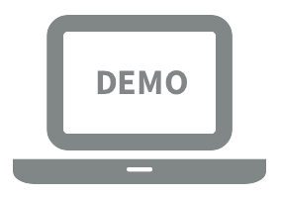
Let’s take a tour - R / RStudio
Notes:
Let's take a look at what R can do…

Slide 21
Concepts introduced:
Console
Using R as a calculator
Saving sequences of commands in an R script
Environment
Loading and viewing a data frame
Accessing a variable in a data frame
R functions

Slide 22
R (absolute) basics
Most things are functions:
do_this(to_this) do_that(input=to_this, argument1=value)
Assign results to an object:
myObject <- 2 * 2
Notes:
We'll get into the basic building blocks of R object types later, but for now, to get us started the most important things to know are that most of the actions in R are functions. Functions take arguments. The arguments to the functions have name and value pairs. You can reduce the amount you type by dropping the argument name and supplying the values which are then assumed to follow the order of the named arguments. If you're starting out in R then I totally recommend fully specifying the name and value and we'll see that RStudio actually makes that approach easy.
In functions, we use "=" to assign values to argument names.
In R scripts, we assign values to objects using the left arrow "<-".
The latter isn't a hard and fast rule, but I'm going to use that convention and I suggest you do too.

Slide 23
R Packages

Slide 24




help
help
help
help
help
help
help
help
help
function1()
function2()
function3()
function4()
function4()
function5()
function6()
function7()
function7()
function8()
function9()
function10()
function11()
“base R”
R “Packages”
CC BY-SA RStudio
Notes:
In R there are bundles of code, functions, data and help that make up things called packages.
These packages help us do specific tasks within R and they are usually focussed on one particular task.
When you install R it comes with a basic set of packages which together are known as "base R".
Other packages bundle together code, functions, data, help files, and in some cases they borrow
functions from other packages.

Slide 25
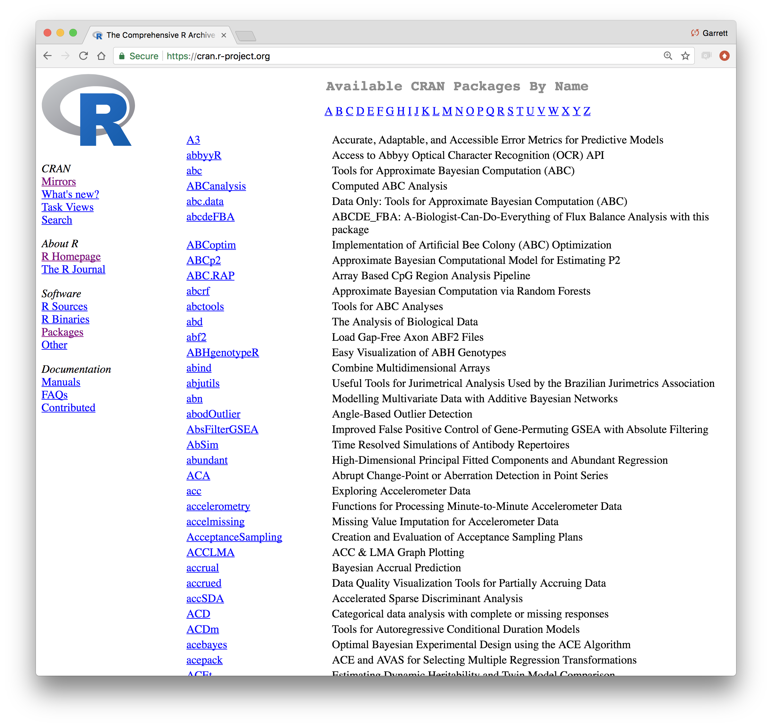
CC BY-SA RStudio
Notes:
The power of R is that there are packages covering a massive range of data analysis topics. There are now over 15,000 packages.
You should take a look at the "Task Views" link on the left hand side which aims to collect together packages that cover particular analysis problems.

Slide 26
Using packages
1
2
install.packages("foo")
library("foo")
Downloads files to computer
Loads package
1 x per computer
1 x per R Session
CC BY-SA RStudio
Notes:
To install packages you need to use the install.packages function. You typically do this once…
Then within each R session (or typically at the top of each R script) you need to load the library BEFORE you use it.

Slide 27
The Tidyverse

Slide 28
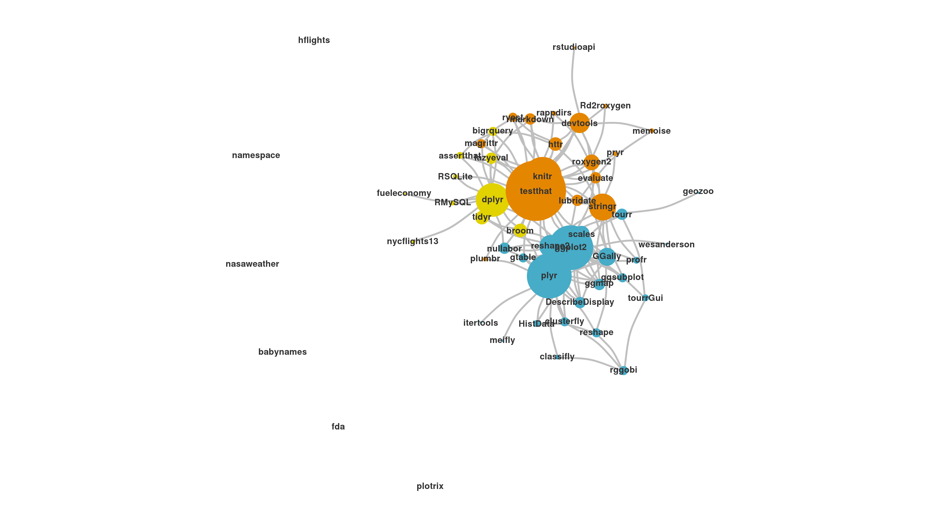
The Tidyverse
A collection of modern R packages that share common philosophies, embed best practices, and are designed to work together.
Display by Adolfo A ́lvarez
CC BY-SA RStudio
Notes:
The tidyverse is a collection of packages designed to work together for data science work.
It's a shortcut for installing and loading a number of packages.

Slide 29
install.packages("tidyverse")
does the equivalent of
install.packages("ggplot2")
install.packages("dplyr")
install.packages("tidyr")
install.packages("readr")
install.packages("purrr")
install.packages("tibble")
install.packages("hms")
install.packages("stringr")
install.packages("lubridate")
install.packages("forcats")
install.packages("DBI")
install.packages("haven")
install.packages("httr")
install.packages("jsonlite")
install.packages("readxl")
install.packages("rvest")
install.packages("xml2")
install.packages("modelr")
install.packages("broom")
CC BY-SA RStudio
Notes:
When you install the tidyverse you get all of these packages

Slide 30
tidyverse
An R package that serves as a short cut for installing and loading the components of the tidyverse.
library("tidyverse")
CC BY-SA RStudio
Notes:
And then you can load up a number of these by loading a single package

Slide 31
install.packages("tidyverse")
library("tidyverse")
does the equivalent of
does the equivalent of
install.packages("ggplot2")
install.packages("dplyr")
install.packages("tidyr")
install.packages("readr")
install.packages("purrr")
install.packages("tibble")
install.packages("hms")
install.packages("stringr")
install.packages("lubridate")
install.packages("forcats")
install.packages("DBI")
install.packages("haven")
install.packages("httr")
install.packages("jsonlite")
install.packages("readxl")
install.packages("rvest")
install.packages("xml2")
install.packages("modelr")
install.packages("broom")
library("ggplot2")
library("dplyr")
library("tidyr")
library("readr")
library("purrr")
library("tibble")
CC BY-SA RStudio
Notes:
Notice that installing gets LOTS of packages, while loading the tidyverse only loads a subset of that.

Slide 32
Tidy tools
Functions are easiest to use when they are:
Simple - They do one thing, and they do it well
Composable - They can be combined with other functions for multi-step operations
Smart - They can use R objects as input.
Tidy functions do these things in a specific way.
CC BY-SA RStudio

Slide 33
Tidy data
Tidy functions all expect and return the same data structure, known as tidy data:
CC BY-SA RStudio

Slide 34

What do you mean by “tidy”?
Notes:
So here’s the crux of the tidy idea (and it’s not too peculiar):
Each variable in a dataset should be in one column.
Each observation should be on a row.
Each cell should represent one value.

Slide 35
Reproducibility

Slide 36
GOAL: Reproducible data analysis

Slide 37
Reproducibility checklist
What does it mean for a data analysis to be “reproducible”?
Will we be able to consistently reproduce this analysis at an arbitrary point in the future?
Is there sufficient detail accompanying this analysis to understand the assumptions, inputs, choices made?
Can we extend this analysis to cover new data?

Slide 38
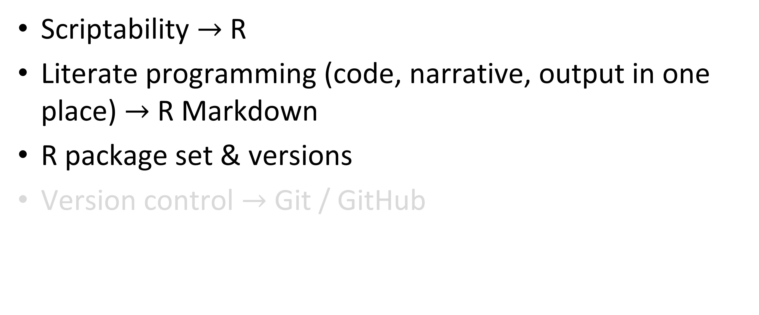
Toolkit
Scriptability $→$ R
Literate programming (code, narrative, output in one place) $→$ R Markdown
R package set & versions
Version control $→$ Git / GitHub
Notes:
When it comes to reproducibility there are many things to consider
Scriptability ensures that all manipulations, analyses and visualizations of your data are tracked and reproducible.
Literate programming – meaning that you interleave explanation of what you're doing and why with the actual code and results, essentially writing a report WHILE YOU CODE – means that third parties have a way of understanding your thought process, as well as the code to reproduce the output. We'll see this in Rmarkdown
Finally we need to ensure that we communicate what version of R we're using, what R packages and what versions of R packages are being used. This allows a third party to recreate the environment that you run with.
We're NOT going to cover version control since in most cases this will be provided by the improve M&S system, Stats Workbench or the SIGMA system for SPA.

Slide 39
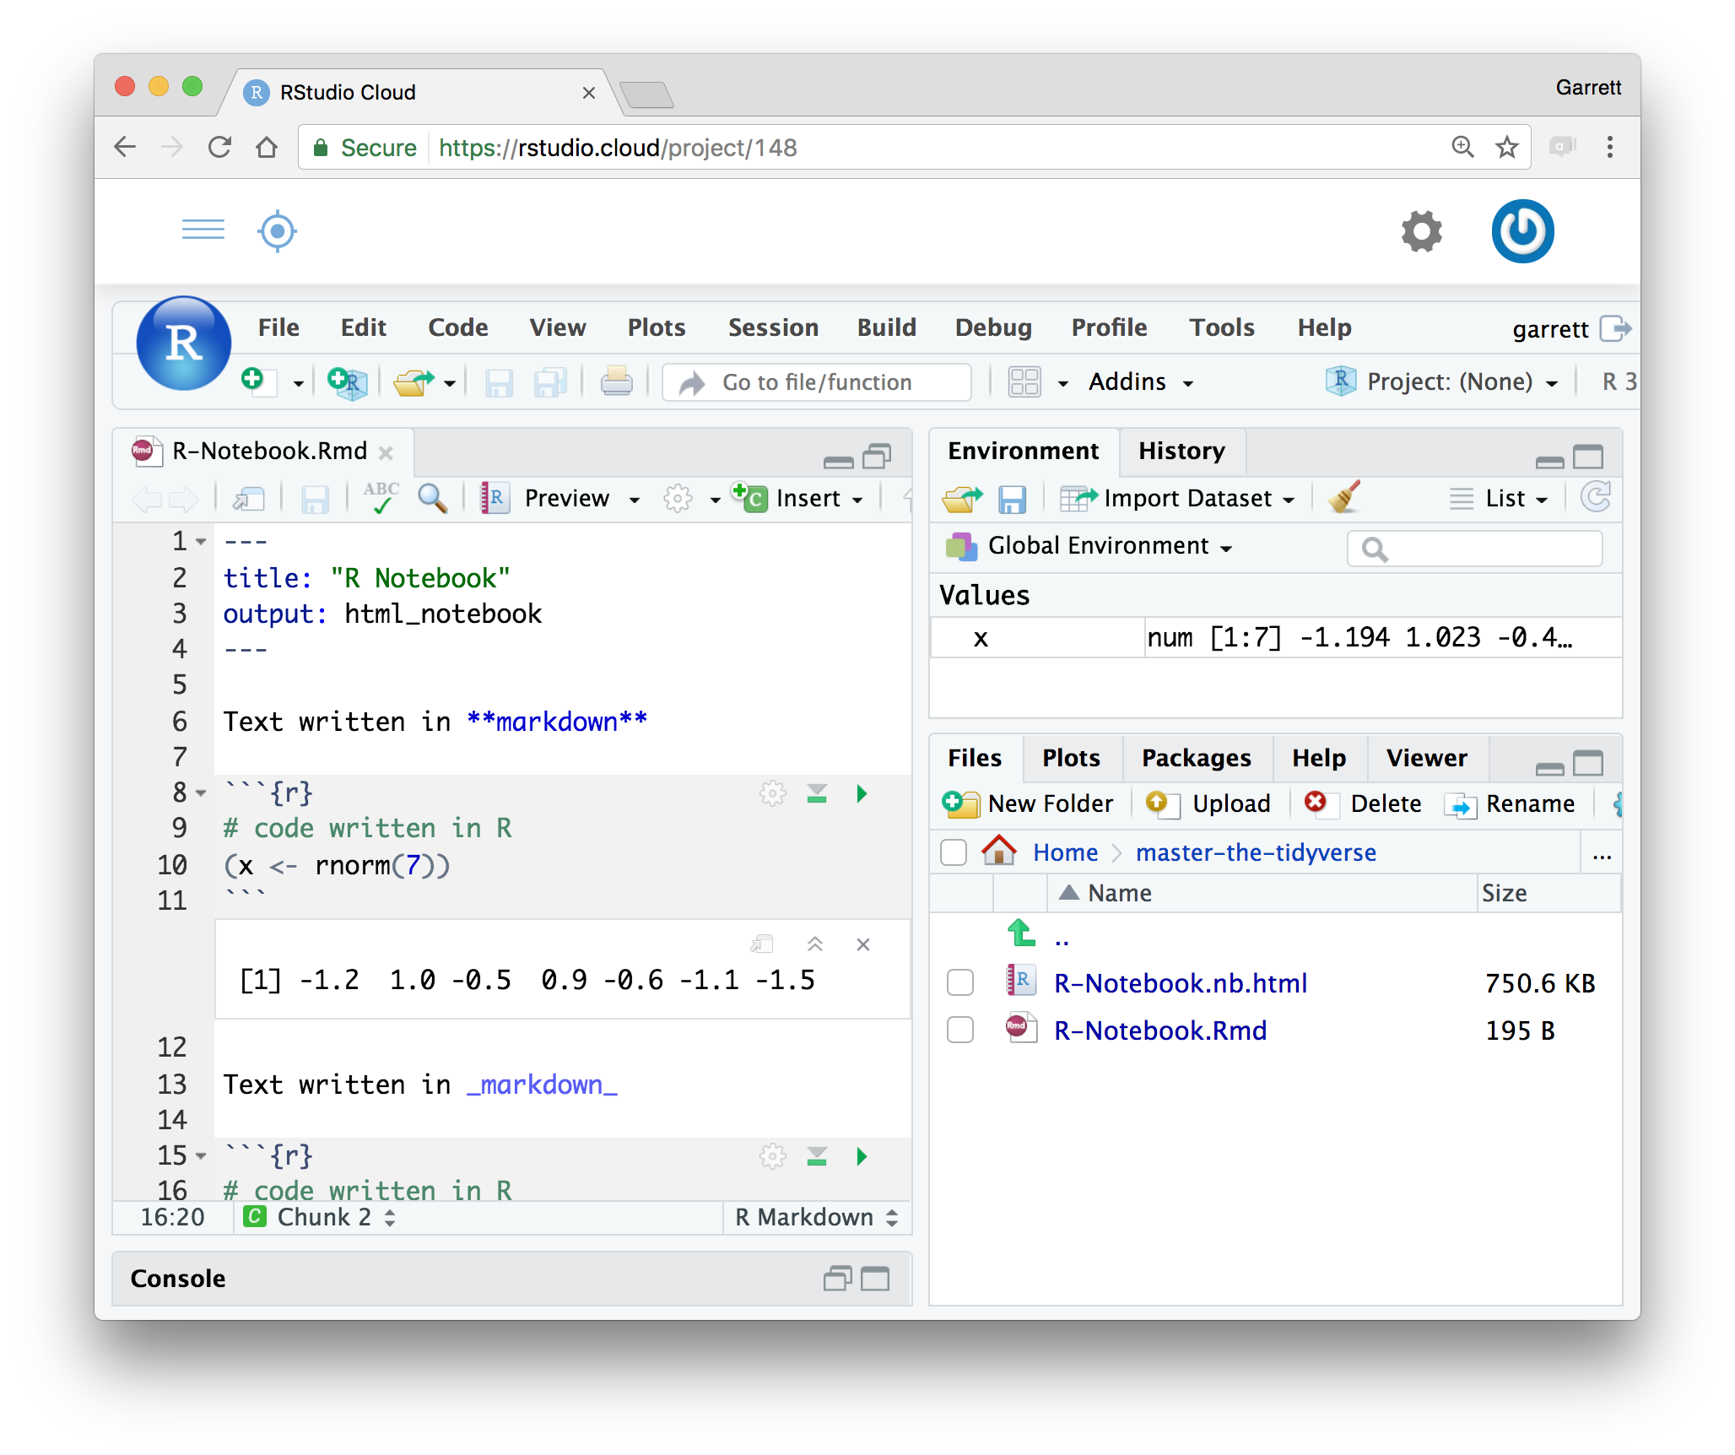
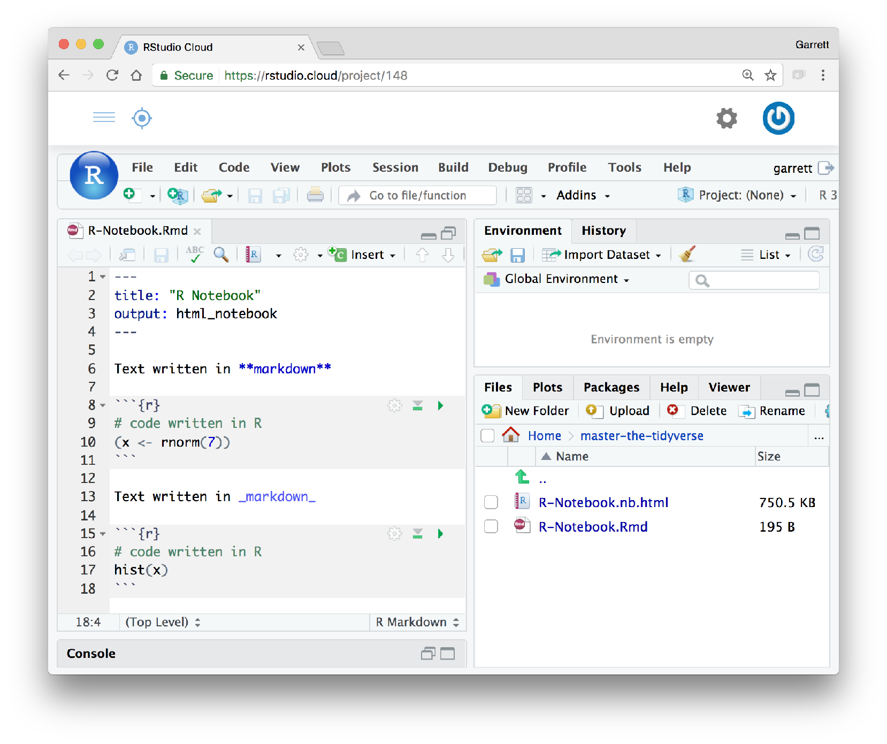
R Notebooks
An authoring format for Data Science.
Click to run all code chunks above
Click to run code in chunk
Code result
CC BY-SA RStudio

Slide 40
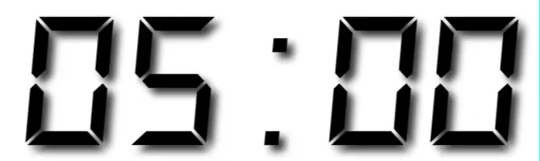
Your Turn
Open /exercises/00-Introduction.Rmd. Read through the notebook and do everything it tells you to do.

